Slide 2
—
Define the problem
What is the problem that your app is solving?
Tips
The problem can be trivial, such as relieving boredom through a game, or something more significant like helping people to control their finances.
It should be one succinct sentence. This will then feed into your app’s vision statement.
Your problem statement should have a clear, narrow purpose. For example, “to help toast connoisseurs find high quality toast near them”.

Slide 3
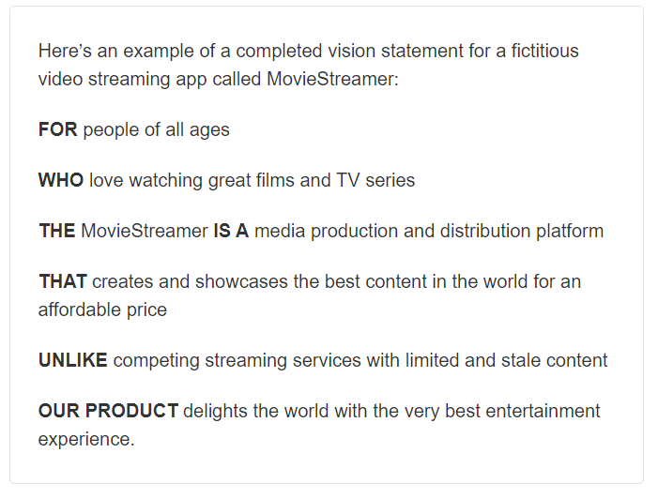
—
App Vision example

Slide 4
—
App Vision
FOR [target customer]
WHO [statement of need or opportunity]
THE [your app name]
IS A [what does your app do?]
THAT [what is your app’s unique selling point?]
UNLIKE [how does your app differ from the competition]
OUR PRODUCT [what is the philosophy behind your app’s existence?]

Slide 5
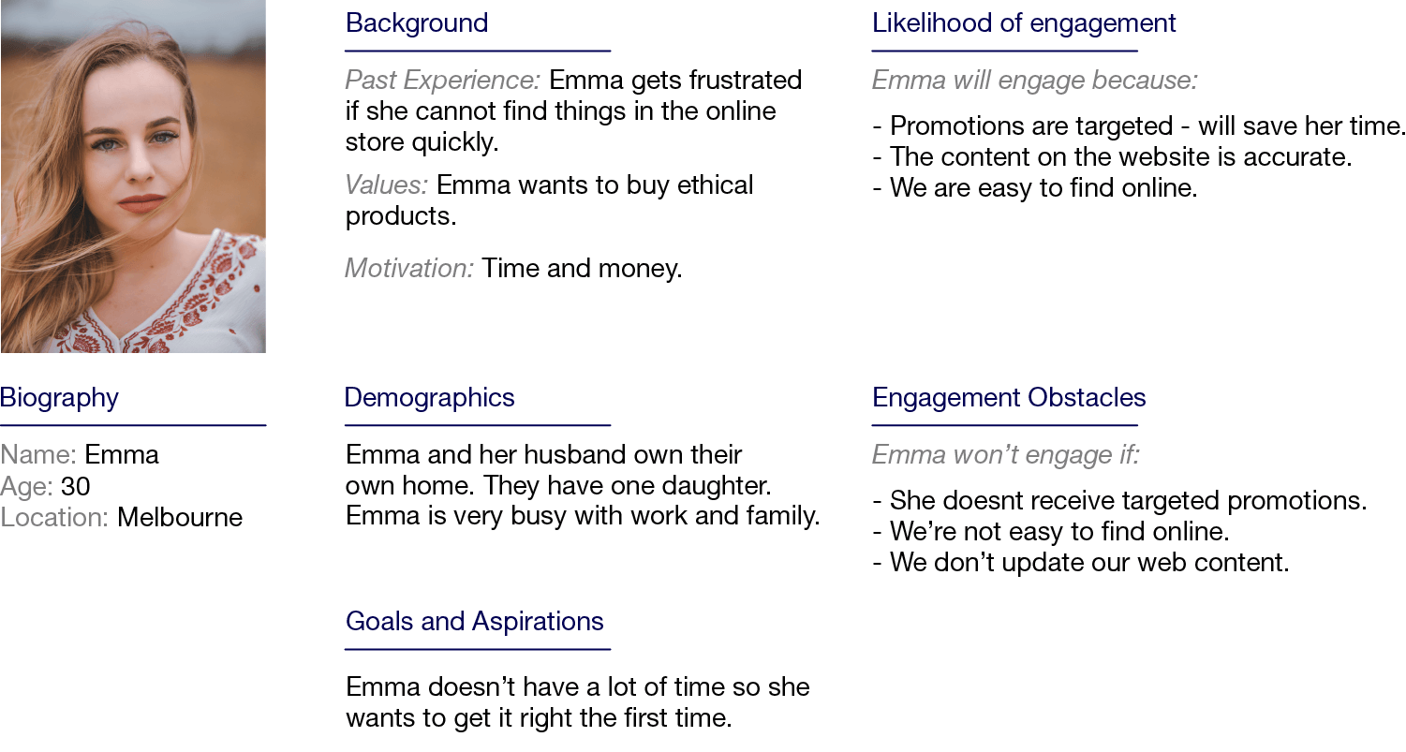
—
Persona example

Slide 6
—
Persona
Background
Likelihood of engagement
Past experience:
Values:
Motivation:
Add photo here of person who represents your persona
Biography
Name:
Age:
Location:
Demographics
Engagement obstacles
Goals and aspirations

Slide 7
—
Create a feature set
What are the essential features you’re going to build into your app?
Tips
Start by getting the ideas flowing. List every feature you can think of – you can trim the list later.
Make sure the feature of your app are relevant to your problem definition, vision and persona.
Example: For an app which helps users find more tasty toast nearby, the features might be: - find toast nearby, find top toast, post toast, rate toast, review and discuss toast, and get alerts about toast. Once the list is trimmed to a minimum viable product, the features may end up being: - find toast nearby, find top toast, and rate toast.

Slide 8
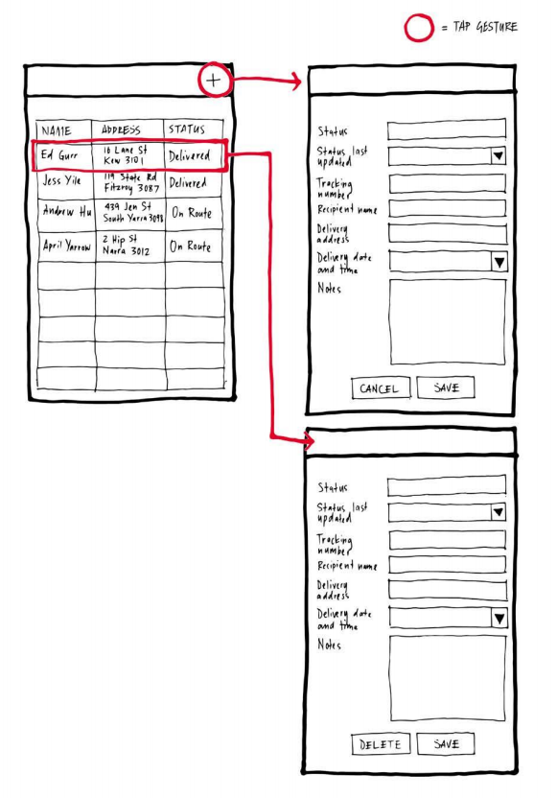
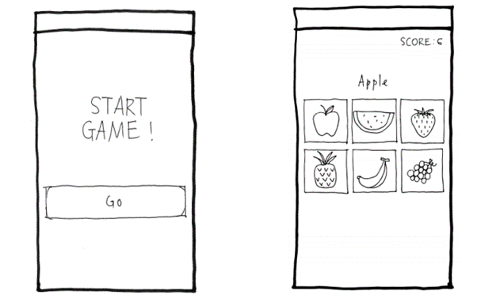
—
Wireframe examples (covered in Milestone 5)

Slide 9
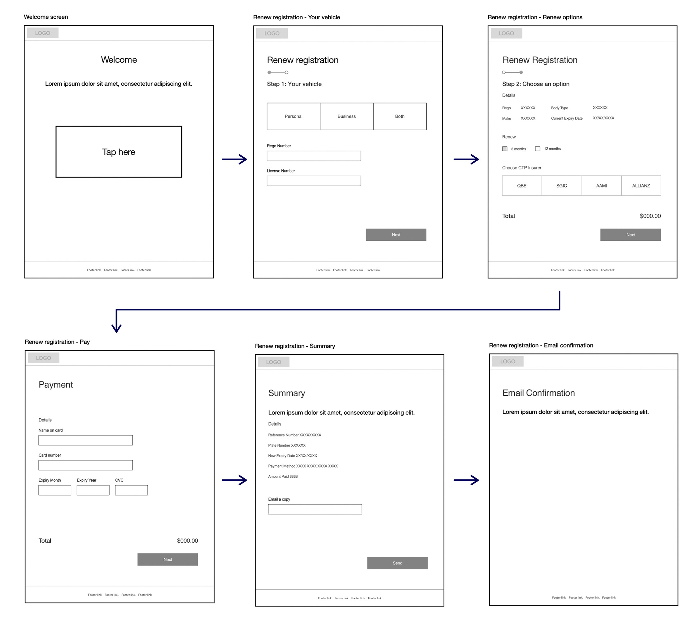

Slide 10
—
App wireframes
Create wireframe diagrams which demonstrate how the app in your Final Project will look and how it will work.

